Slide 1
Cognition Fundamentals: Refresher
Perception and Learning
Responsible Lecturer: Bram Heijligers

Slide 2
What will we do today?
Finalize human cognitive system required for bin-picking task. Design the robotic system based on the finding made using the cognitive model.
Cognitive systems discussed this block:
Perception: Visual (& kinaesthetic)
Memory: Learning
Reasoning: Decision-making
Emotion: Learning & motivation/goals setting
Today:
Morning: Refresher on perception and memory, process feedback, iterate, design robot
Afternoon: Lecture on reasoning & decision making, expand on cognitive and robotic model

Slide 3

Phones please
As you will recall from last workshop, I scientifically proved that in order to learn well you should hand in your phone and close your laptop during and after the lectures!
Please hand them in now!

Slide 4
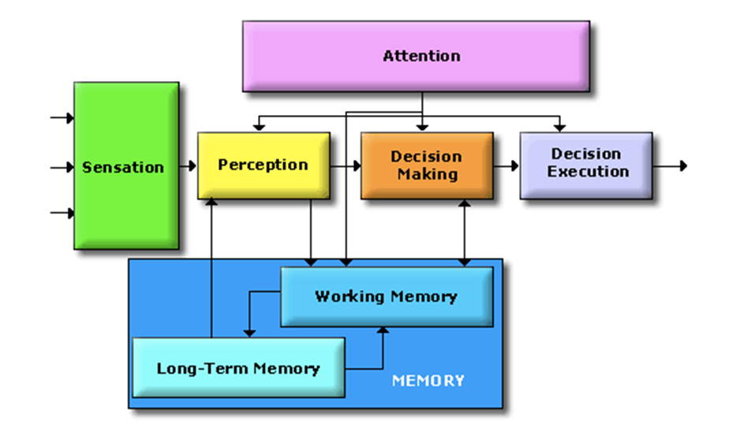
The Cognitive System
Cognitive scientists study intelligence and behavior, with a focus on how the nervous systems represent, processes, transforms, stores and recoveres information.
Essentially, information is captured by ‘sensors’
from where it is processed and in different ways:
Like data flowing through an
algorithm!
Key difference is the human minds
limited processing capacity which is
why we need attention! → Selection!
Not actually separate parts; nothing is truely separate, but
classification is how humans deal with information → r.i.p. us
Notes:
On the separate parts:
This approach is taken to aid clarity of explanation, but in so doing, can give the impression that individual aspects of cognition can be understood in isolation from each other. However, it is always important to remember that to properly understand the role of any single aspect of cognition we must appreciate how that role is dependent upon and interacts with other aspects.

Slide 5
How do we perceive?
Using our different senses: (Sherrington’s codification)
Teloreceptive (vision and hearing)
Proprioceptive (limb position)
Exteroceptive (touch)
Chemoreceptive (smell and taste)
Interoceptive (visceral, but based on later findings also includes the sense of the physiological condition of the entire body)
may reflect predictions about the expected state of the body rather than actual sensations (Barrett & Simmons, 2015)
For object detection, we’ll now focus on vision!

Slide 6
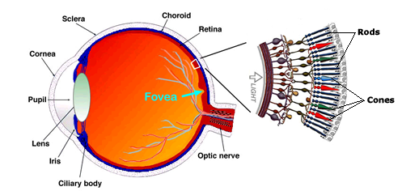
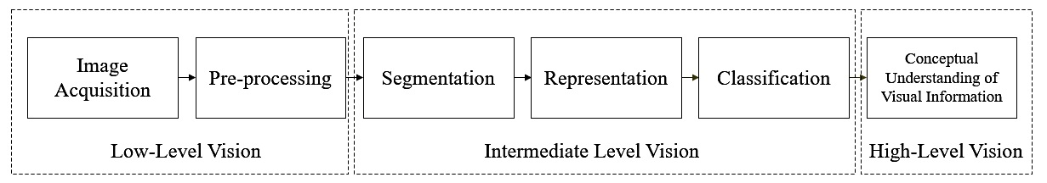
Visual Perception
The information received using the eye is received at a 24 hertz and incomplete; meaning information is missing.
Visual perception uses several processing steps to create a holistic, constant and stable visual experience.
Information is then further segmented, represented, classified (contextualized) and conceptually understood

Slide 7
Visual Attention
Sampling & Prioritizing what we perceive
Cannot take in all visual information at once.
Therefore, shift attention around environment to focus on important sources of information.
‘Spotlight’ metaphor
Attention is like a spotlight which moves about and allows us to selectively attend to parts of the visual world.
Michael Posner (1980) suggested that enhanced processing/detection occurs within this ‘spotlight’.
So attention is directed towards ‘space’ according to the spotlight model. It is a space-based model of attention.
What is missing in the diagram below?

Slide 8
Attention
Windows task manager for humans
Attention is how the brain controls its own information processing
Can be measured through conscious introspection, overt and implicit behaviors, electrophysiology and brain imaging
External attention – selection and modulation of sensory information
Selects locations in space, points in time, or modality-specific input
Feature-based or object-based
Integration of objects/features over space, time and modality
Internal attention – selection, modulation and maintenance of internally generated information
High-level cognitive (thoughts, plans, rules & responses, self-monitoring, memories)
Low-level cognitive (bodily functions – pain, hunger, etc.)

Slide 9
Attention
Windows task manager for humans; for our purposes
LIMITED CAPACITY – evolved out of necessity to focus limited processing capacity to the most important information
SELECTION – multiple stimuli compete for selection and the goal is to select the stimulus most relevant to current tasks and goals;
MODULATION – once a stimulus is selected, attention also determines how well it will be processed, how fast and how accurately, and whether it will be later remembered
VIGILANCE – closely related to modulation (which is limited in time and has immediate effects); the ability to sustain attention over extended periods of time

Slide 10


Rewards & Motivation
Motivation is what motivates us; lies at the base of intelligence
Reinforcement Learning is learning what to do and how to map situations to actions. The end result is to maximize the numerical reward signal. The learner is not told which action to take, but instead must discover which action will yield the maximum reward.

Slide 11
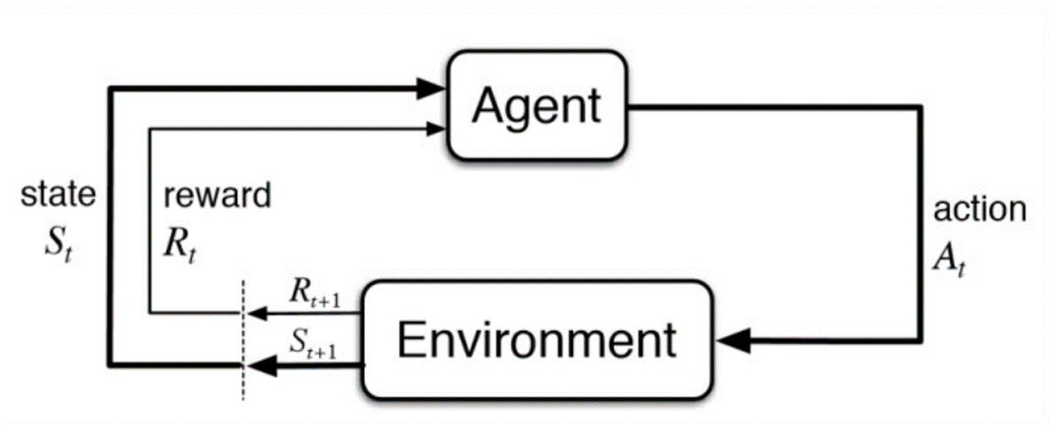
Reinforcement Learning

Slide 12
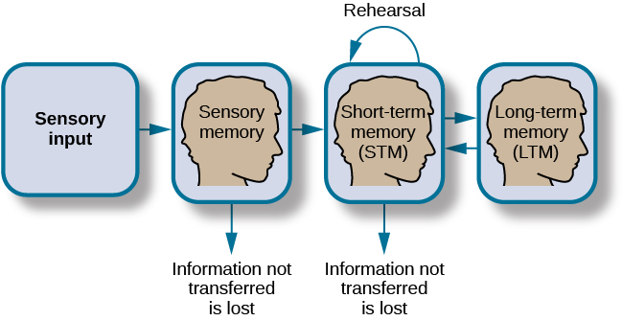
How memory functions

Slide 13
Sensory Memory
Memory that preserves the characteristics of a particular sensory modality: the way an object looks, sounds, feels, etc.
Large capacity and short duration (cmp. Working Memory – more persistent but limited to a few items)
Echoic – up to 4 seconds; “What did you say?”
A: ‘What time is it?’
B: What did you say? Oh, it’s 3 o’clock.”
Iconic – images
Why the duration limit if large capacity?

Slide 14
Working Memory
“ a term…used widely, but without much agreement”
A mechanism that keeps a small amount of information that is particularly task-relevant in a privileged state in which it can be accessed easily (Cowan, 2015)
The information can come from recently experienced events or from LTM
Storage an information as well as the manipulation of that information by central executive processes (Baddeley & Hitch, 1974)

Slide 15
Types of Memory: the brain as a database
Memory
Sensory (< 1 sec)
Working/Short-term (<1 min)
Long-term (< end of days)
Procedural (implicit; skills)
Declarative (explicit; facts)
Episodic
Semantic
Iconic (images)
Echoic (sounds)

Slide 16
Attentional & Memory
So, what happens why you have attentively watched this lecture?
It was continually selected for perceptual processing; for storing in you short-term memory; declarative knowledge → you can retrieve and express it in language
Memory Type I processing: One of the types of rehearsal in the levels of processing approach, in which information is recirculated at the same level with no additional processing for depth. (repeat set of words)
If you then start applying it in class to design you perceptual model/computer vision information pipeline, then you are really learning; demonstratable knowledge
Memory Type II processing: According the levels of processing approach, this type involves recoding of information to another level of depth and leads to a more durable memory trace. (remember set of words)
So, why the workshops?

Slide 17
Break
Take a walk of 5 minutes and meet me at the Innovation Square!
Be back in 20 minutes for the perception lecture!

